Slide 1
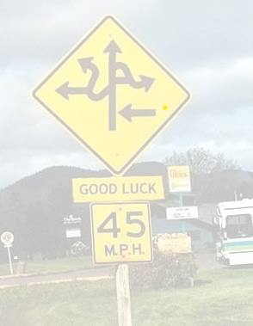
Beyond the yellow diamond
Team Crash
https://www.github.com/srish/crashers

Slide 2
Crowd-sourcing perception
GPS combined with
sensors in the car….
public data sources….
the kindness of strangers….
extends the driver’s means of perception beyond sight and sound into the

Slide 3
Beyond the yellow diamond
Your GPS warns you of upcoming hazards:
dangerous intersections
potholes
reports can be tuned to time-of-day, current weather conditions: slippery when wet (and it’s wet now)
Your get-me-directions server ….
can optimize routes to avoid hazards
can annotate directions with hazards

Slide 4
A GPS that warns you
…you are approaching a dangerous intersection…
…frequent icy conditions here….

Slide 5
Impact (the good kind)
Beyond the yellow diamond: Drivers more aware of potential hazards – and are better prepared for them
Insurance companies give a discount to drivers that take advantage of the system

Slide 6
Hazard inputs
Geotagged accident reports from recent years (e.g., <insert URL>)
Geotagged pothole notices (e.g., <insert URL>)
Pothole reports from voluntarily-uploaded OBD data

